Slide 1
Virtual Venue Speaker Training

Slide 2
The Virtual Venue Overview
Technology requirements
Virtual venue preparation before the event
Navigating around the new Virtual Venue
How to participate in your session as a speaker

Slide 3
The Virtual Venue
CERF 2021 will be hosted on Pathable, a virtual event platform. This will be our Virtual Venue.
The Virtual Venue uses a Zoom integration for all virtual meeting components, such as the “Enter Video Meeting” option on exhibit booths and for one-on-one meetings.

Slide 4
Virtual Venue Preparation Before Event
You will receive a link from CERF to sign into your account on the Virtual Venue. You can find this link by looking in your email for “Log In to the CERF 2021 Virtual Venue.”
Virtual Venue
Notes:
In addition to being an extremely user-friendly platform, our Virtual Venue prioritizes the connection and community that make our online conference feel like we are back in-person.
Attendees will have the chance to meet up with new contacts and familiar friends, participate in community events, and connect with exhibitors on our virtual exhibitor floor.

Slide 5
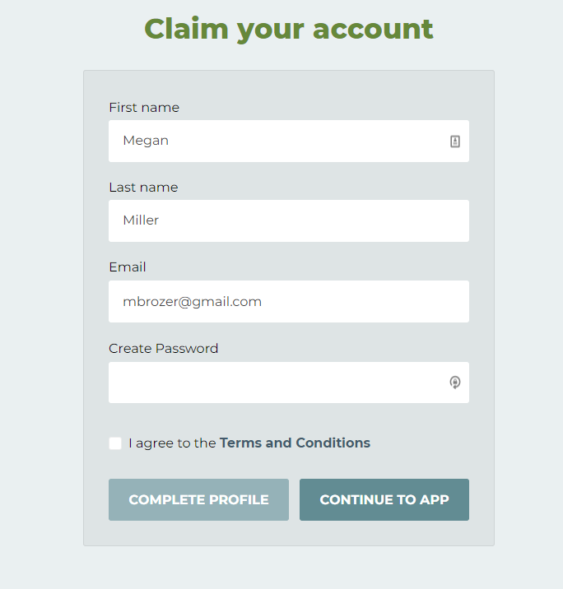
Email from no-reply@pathable.com
Create your account

Slide 6
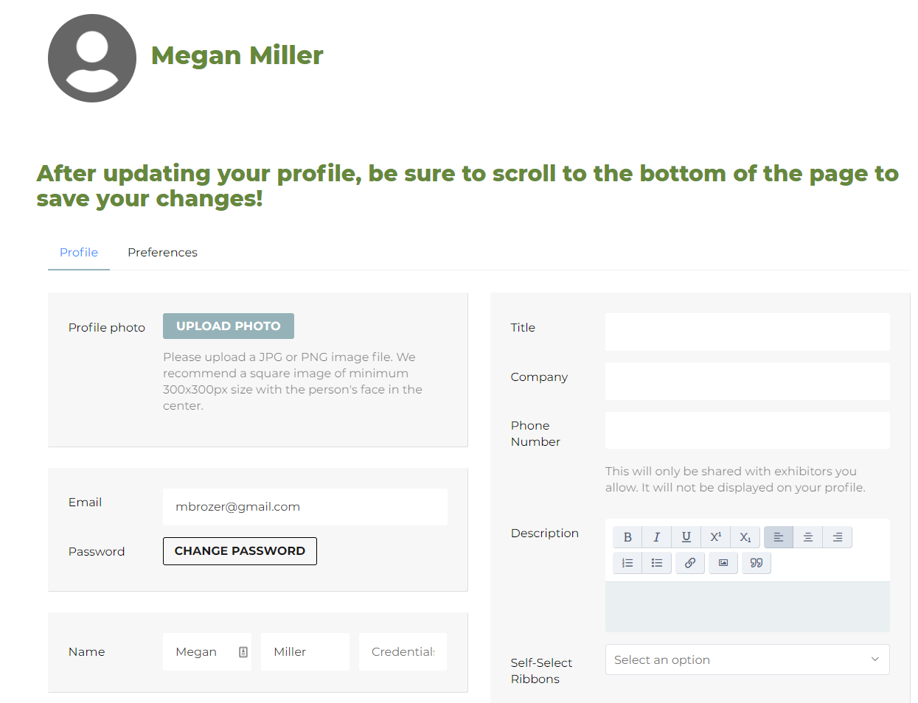
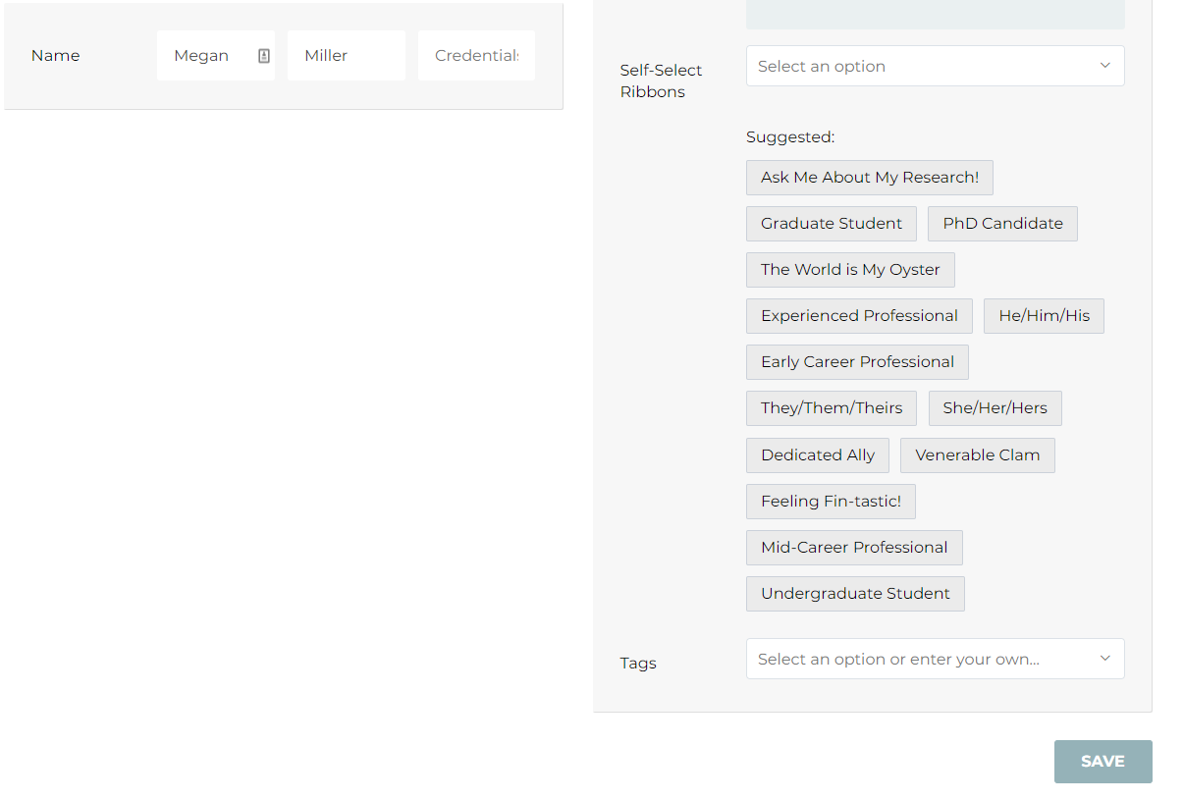
Create your Profile

Slide 7
How to Log In and Edit Your Session
Once you are logged in, you can navigate to the “Schedule” menu item and select “Agenda”.
You will then scroll down to find your session and select your session
Virtual Venue

Slide 8
How to Log In and Edit Your Session (cont.)
In your session page, you can add any files or supporting documents under the manage button.
Virtual Venue

Slide 9
Before Your Session
You will join a CERF team member, any co-presenters, and your session host in the “Green Room” 20 minutes prior to the session block start time.
In the Green Room, you will:
Test your microphone, video and virtual background
Update your name on Zoom
Connect with your session host to confirm introductions
Address any technical questions and session timing
5 minutes before the session block starts, a looping slideshow with light music will play for attendees as they filter in.
Presenter To-Dos

Slide 10
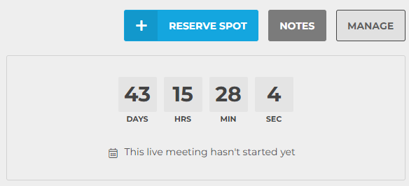
How to Join Your Session
Click the manage button to join the green room and check in on how many people are interested in your session.
The pre-session “green room” will open for session hosts and speakers 20 minutes before the session start time.
To enter, from the session page click “Manage” in the top right corner. Then, click the “Join Meeting” button.
Joining this way automatically makes you a session co-host with screen-sharing abilities and prevents technical hiccups.
The “Join Meeting” button will replace the countdown timer in the manage tab 20 minutes before the session starts.
Virtual Venue

Slide 11
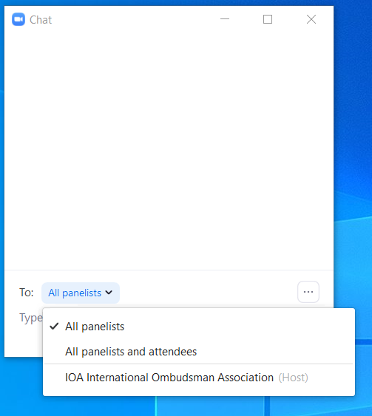
Zoom Controls
Your Presenter Screen on Zoom
Presenter screens will have your presentation and presenter controls.
CERF Office (Host)
John Smith
Jane Doe
John Smith
Jane Doe
Use reactions during sessions to clap, give a thumbs up, and more!
LWHRA Office (Host)
Mute yourself when you are not speaking.
Toggle your camera on and off. Camera can be toggled on during your introduction and during your relevant Q&A
Exit the session.
View the number of participants in the session.
Click on this window to view the list of participant names.
Chat with staff, other speakers, and session hosts. Attendees will ask questions on the Virtual Venue. Choose the audience from the drop down menu.
Technology Overview

Slide 12
During Your Session
The looping slides with music will stop and your session host will be spotlighted for all attendees.
Your session host will introduce the session, share housekeeping reminders with attendees, and introduce speakers.
Hosts will introduce the speakers and the CERF Office will play the pre-recorded presentations.
The session chair will introduce each talk. When its your turn, turn on your camera while the moderator introduces you, then turn it off as your talk is being played. Take note of the questions in the chat.
When your talk is over, Q&A will ensue for anchor talks. The questions will be held during discussion period for the summary talks.
All in-meeting chatter will occur on the session page in the Virtual Venue.
Presenter To-Dos

Slide 13
During Your Session (Continued)
The CERF Office will have a team member in your session for support. Look for the name “CERF Office” if you need any assistance.
Please note: The office will be a silent partner for your session.
This means the office will not be on camera or mic during your session in its entirety.
Please use the chat feature to communicate with the office with any questions or issues during your session.
You will have a session host who is prepared to be on camera or mic to assist.
Presenter To-Dos

Slide 14
Q&A Portion
At the end of each of the anchor talks and at the conclusion of all the summary talks, there will be time for live Q&A.
All speakers in the session should turn on their cameras at this point.
Presenter To-Dos

Slide 15
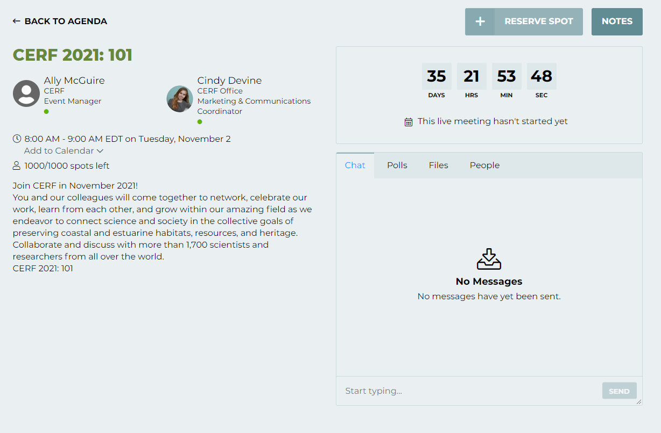
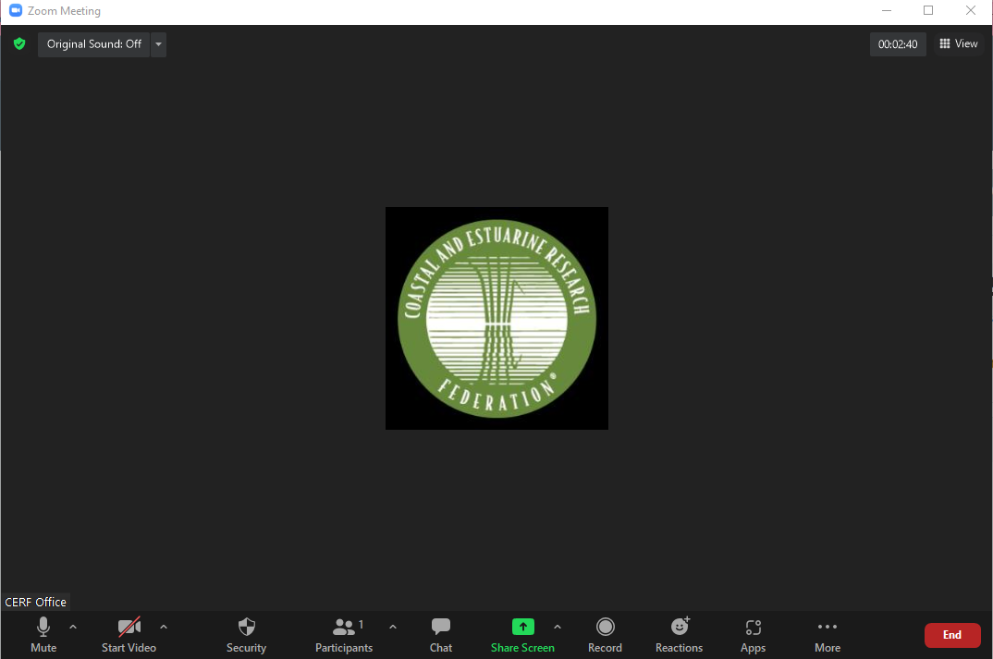
Speaker Split Screen

Slide 16
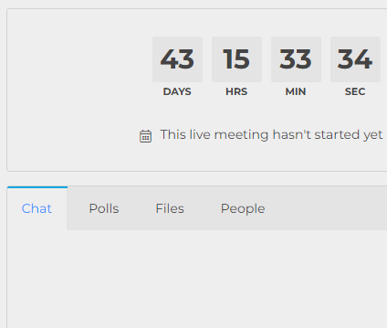
Interacting with Attendees
Where all participants can chat publicly with attendees before, during, and after the session.
Interacting with Attendees
Engage with the Audience On Your Venue Session Page – NOT IN ZOOM CHAT
Visit the Virtual Venue and log in with the credentials you received in your email inbox.
Once you are logged in, you can navigate to the “Schedule” menu item and select “Agenda”.
Find your session and select “Manage.” You can edit the content, add handouts, and create polls, and start a chat.
Speakers also have the ability to edit their headshot and bio within their profile.
Attendees will use the “Chat” tab on the session page to share comments and notes with each other throughout the session.
Session moderators can add questions to the “Polls” tab for visual displays of attendee responses during your session.
The “Polls” tab is also where attendees will go to ask questions for the Q&A portion of your session.
Where attendees can answer polls, and ask questions for post-session Q&A.
Attendees will go here to download presentation files.
View a list of all participants in your session
Virtual Venue

Slide 17
During Your Live Presentation
What to expect

Slide 18
Dress for a Success
Avoid:
Black or gray
Stripes
Busy patterns
Bright colors (especially green if using a virtual background)
Wear:
Solid colors
Jewel tones
Recording Tips & Tricks

Slide 19
Check your Set-up
Video/Visual
Set Up for Success
Check your lighting. It’s best to have light in front of you.
Check your surroundings
Avoid a busy background.
Ensure all notifications are silenced.
Close computer applications such as email or Slack that may cause notifications to appear.
Technology Overview

Slide 20
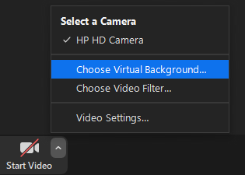
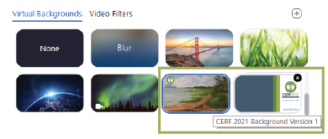
Optional: Applying a Virtual Background
1. Save the CERF 2021 Backgrounds
Download the CERF 2021 Virtual Backgrounds from the Presenter Resources page and save them to your desktop.
2. Add to Zoom & Apply
In your Zoom meeting, click the up arrow next to “Start Video” and select “Choose Background”
Then, click the “+” icon to add your new saved file(s) to the options list.
Select one background from the list and you’re all set!
Presenter Tips & Tricks

Slide 21
Questions? Contact the CERF Office
Office: (206) 209-5262 Email: info@cerf.science
Business Hours: Mon. – Fri., 11:30 AM – 8:00 PM ET 8:30 AM – 5:00 PM PT

